Slide 1
November 2020

Slide 2
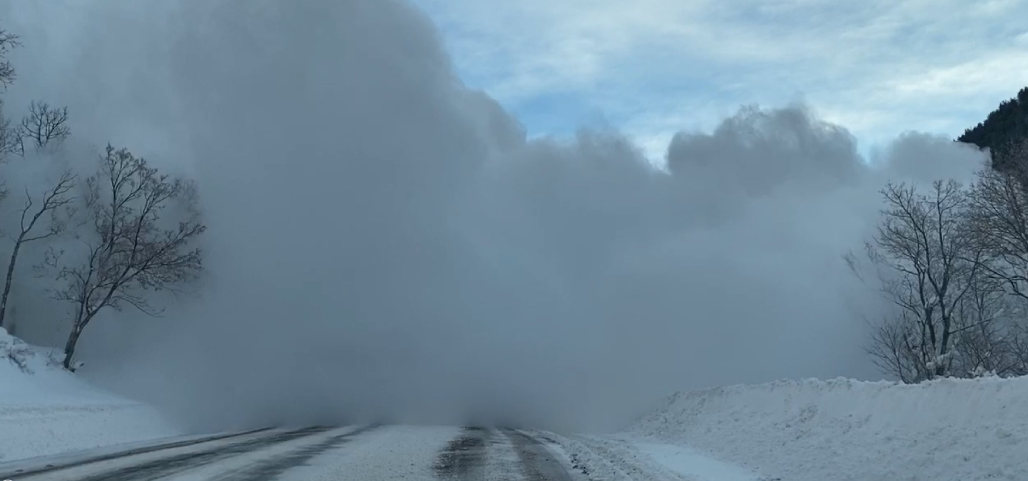
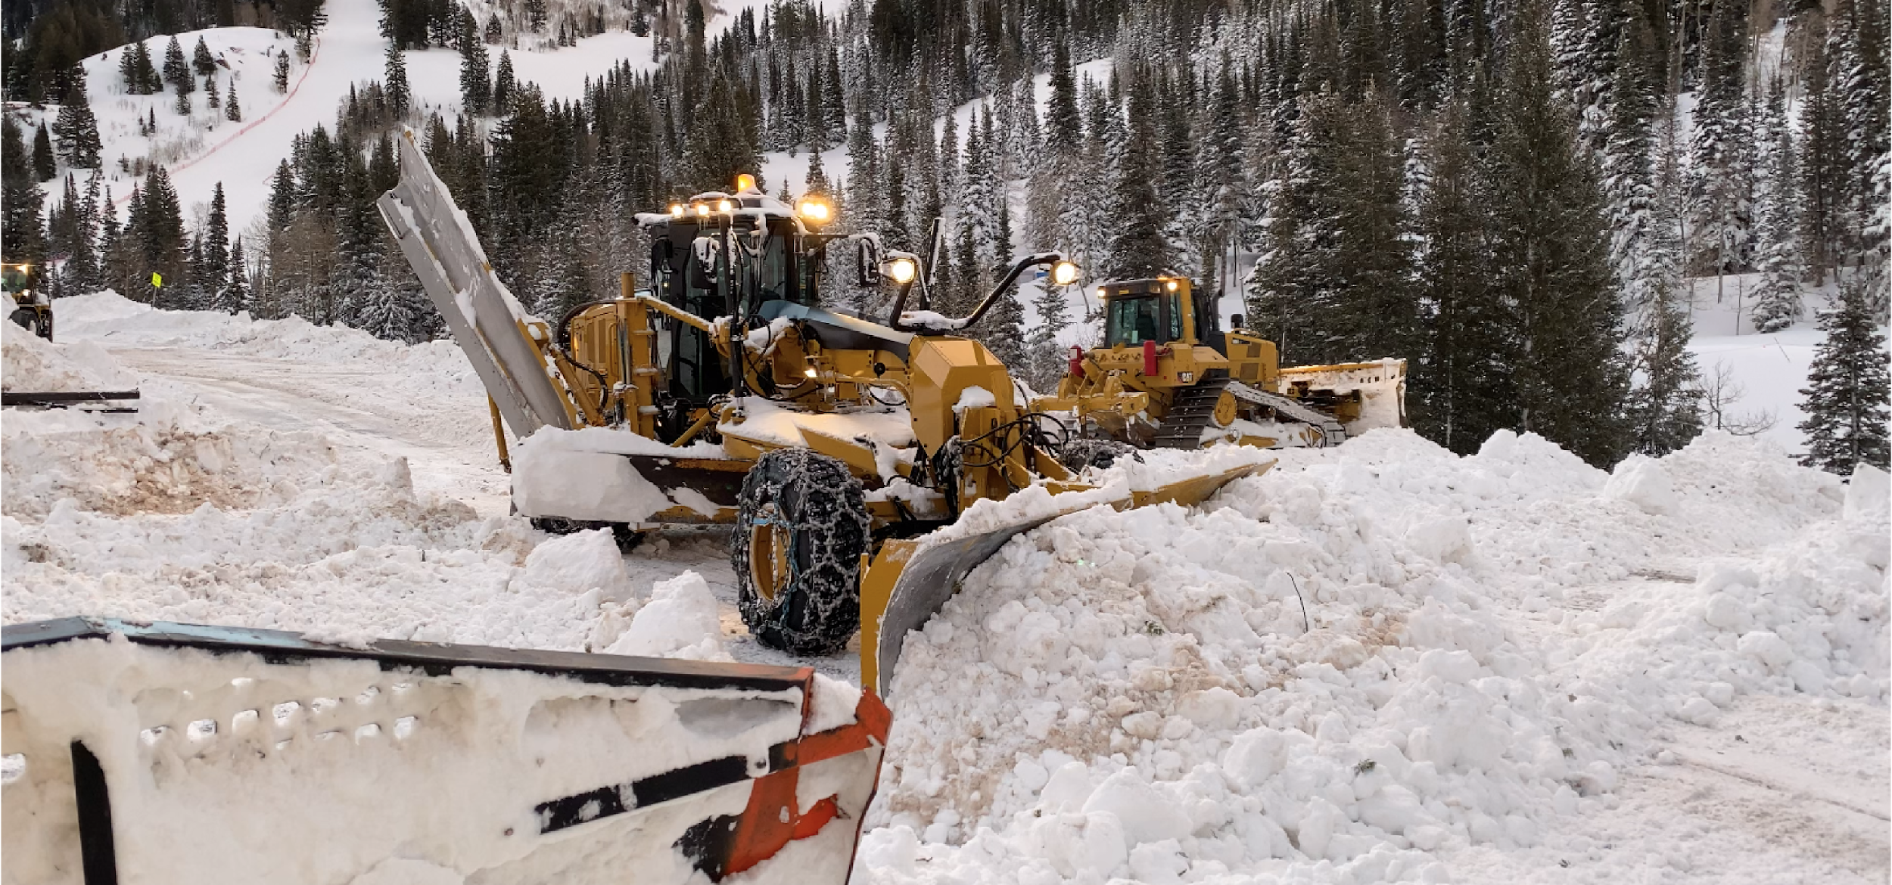
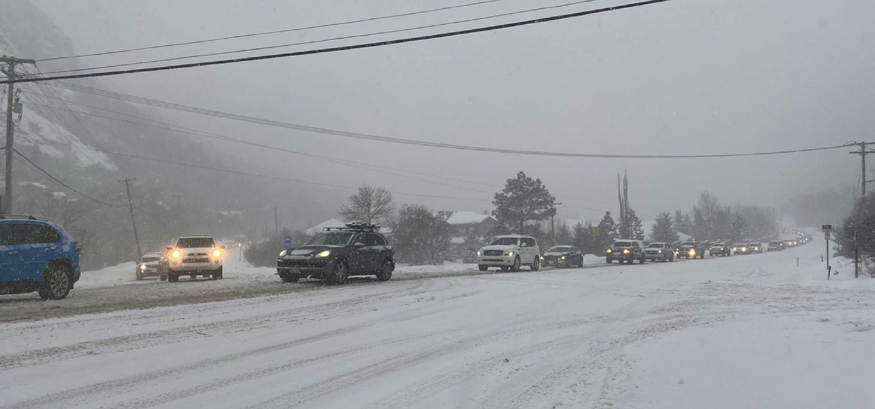
Canyon Challenges

Slide 3
Project Purpose and Need

Slide 4
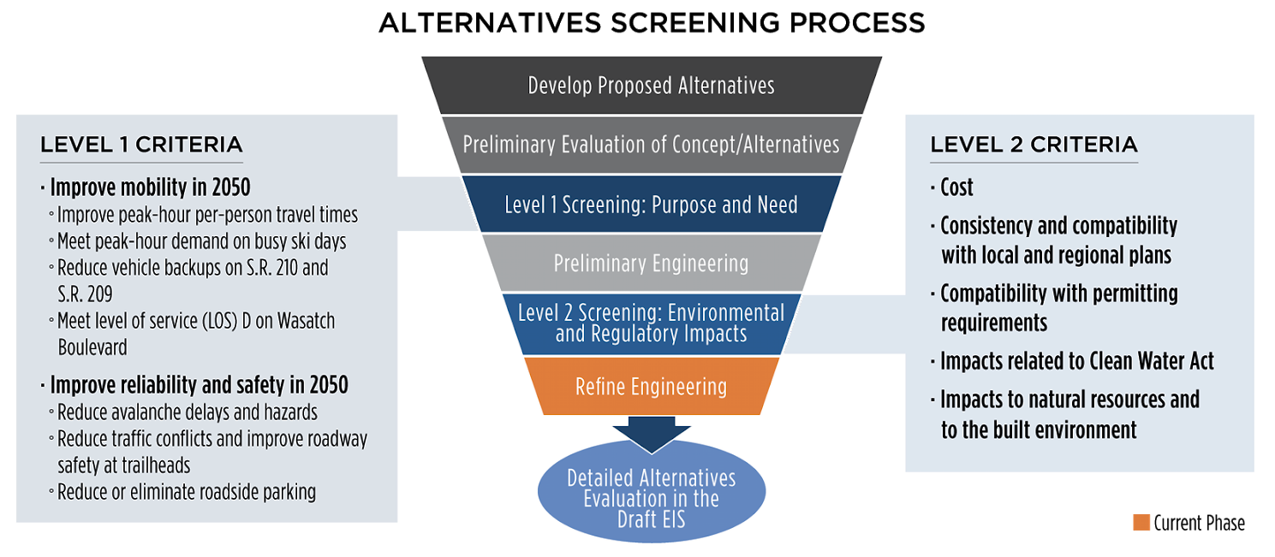
NEPA Alternatives Screening Process

Slide 5
Alternative Commonalities

Slide 6
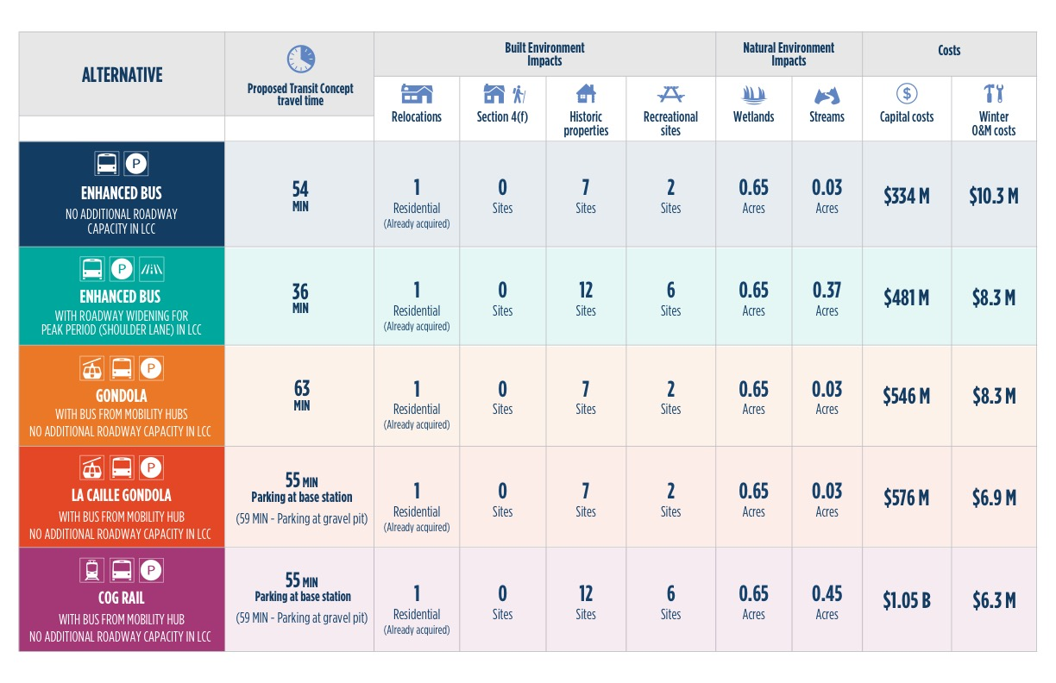
Summary of Alternatives

Slide 7
Enhanced Bus

Slide 8
Enhanced Bus (with Peak-Period Shoulder Lane)

Slide 9
Gondola (at LCC park-and-ride)

Slide 10
Gondola (at La Caille)

Slide 11
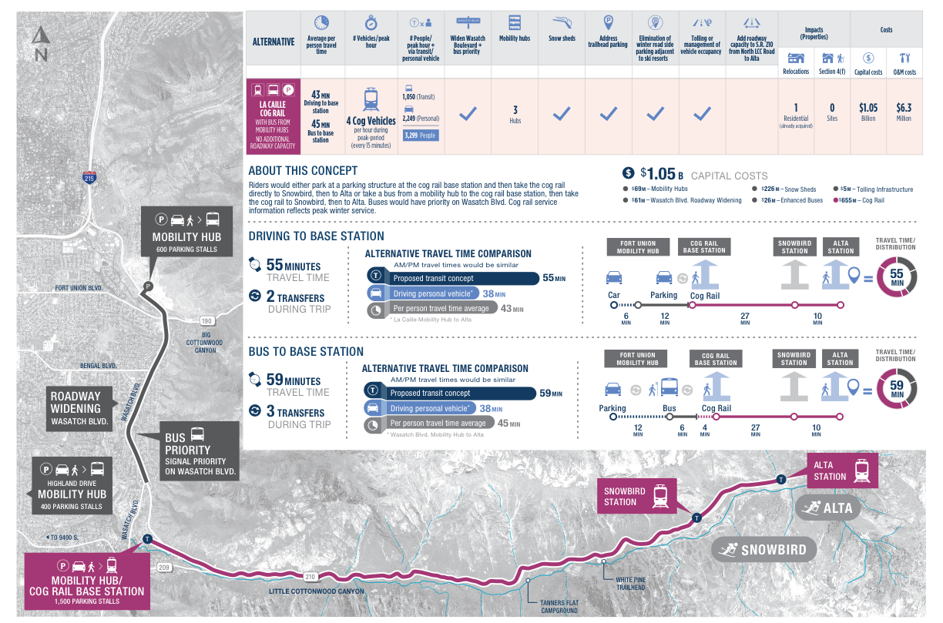
Cog Rail (at La Caille)

Slide 12
Summary of Alternatives

Slide 13
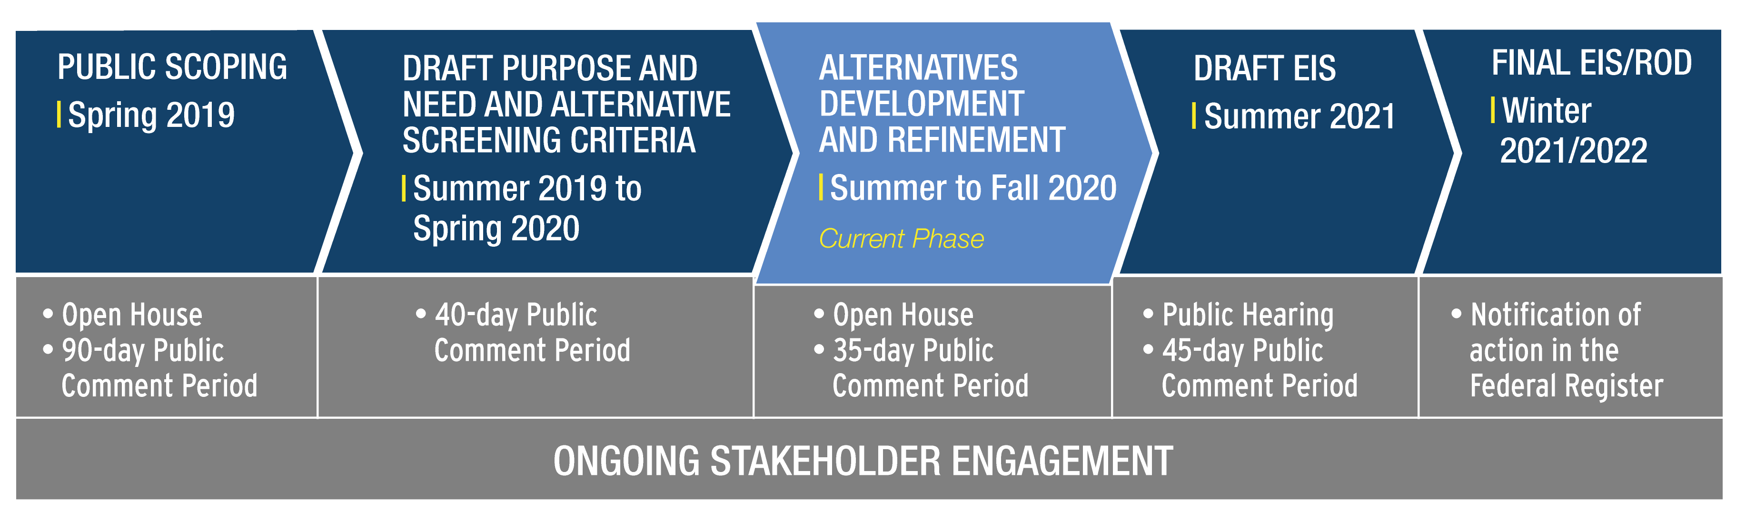
Process and Schedule

